Slide 1
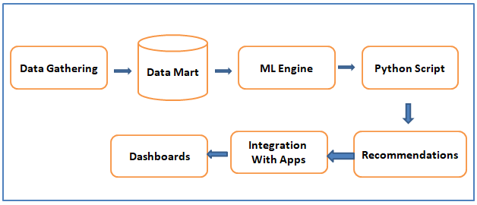
Retail Connect Architecture

